Slide 1
DISPLAYING VIDEOS
AND CHARTS
Baowen Ou & Iiris Kivelä

Slide 2

PROJECT OVERVIEW
•Our Project:
An Android app for users to watch and share videos.
•Our Core Tasks:
•Implement a video section for both videos and user uploads.
•Create charts to show daily app usage and daily time distribution.
•Technical Goal:
Build a scalable and maintainable UI framework using Jetpack Compose and modern Android best practices.

Slide 3
THE TECHNOLOGY STACK
UI
DEPENDENCY INJECTION
100% Kotlin with Jetpack Compose for a declarative and modern user interface.
Hilt for managing dependencies and simplifying the architecture.
ARCHITECTURE
ASYNCHRONOUS OPERATIONS
MVVM (Model-View-ViewModel) pattern.
Kotlin Coroutines & Flow for managing background tasks.
NAVIGATION
Jetpack Navigation for Compose to handle all screen transitions.

Slide 4
APPLICATION WALKTHROUGH
SIGN UP / LOG IN
VIDEO HUB
The first point of entry for any user. A clean and simple interface to create a new account or log in securely. This ensures each user has their own private space for tracking progress and uploads.
This is the main screen after logging in, where browsing and watching videos. It features the official videos and the user's personal uploads.
PROFILE SCREEN
CHARTS PAGE
A dedicated space for the user. This is where they can view their account details and log out of the application.
This screen provides a visual summary of the user's activity. It features a bar chart and a pie chart.

Slide 5
FEATURES
FEATURE 1.
Video Display: Enable users to watch both pre-loaded videos and upload their own content.
FEATURE 2.
Charts: Visualize user engagement and usage status through dynamic charts.

Slide 6
FEATURE 1.
•Core Component:
CustomVideoPlayer composable built using the ExoPlayer library.
•Functionality:
•Handles playback for both remote video URLs and local device URIs (user uploads).
•The video player supports both standard playback and full-screen viewing.
•Manages player lifecycle automatically, tied to the Composable's lifecycle to prevent memory leaks.
•Displayed in a LazyColumn to efficiently handle a potentially long list of videos.

Slide 7
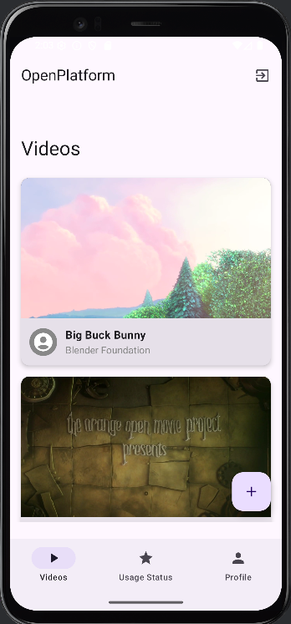
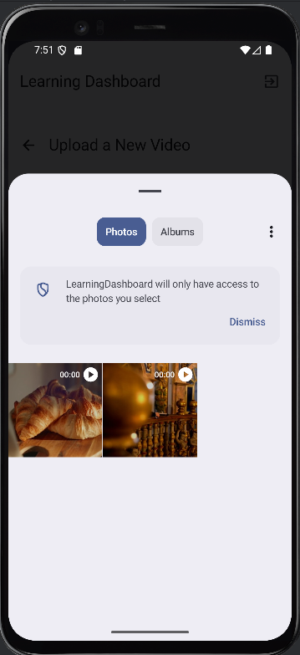
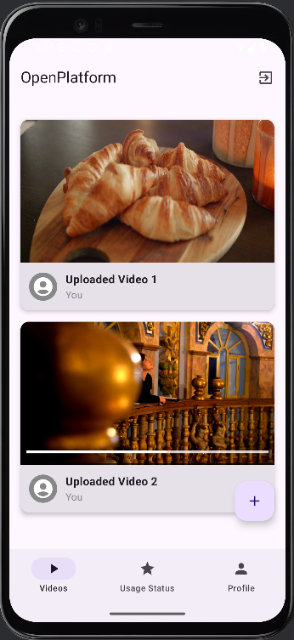
01
02
03
Main screen with videos and user-uploaded videos.
Screen showing the newly uploaded videos added to the list.
Screen to select a video to upload.

Slide 8
FEATURE 2.
•Core Component:
Interactive progress visualization powered by dynamic chart displays.
•Functionality:
•Visualizes user’s usage status using a bar chart for daily activity and a pie chart for usage distribution.
•Data is continuously supplied and updated by the ViewModel, ensuring the charts remain accurate and responsive.
•The chart is seamlessly integrated into the Compose interface using AndroidView.

Slide 9
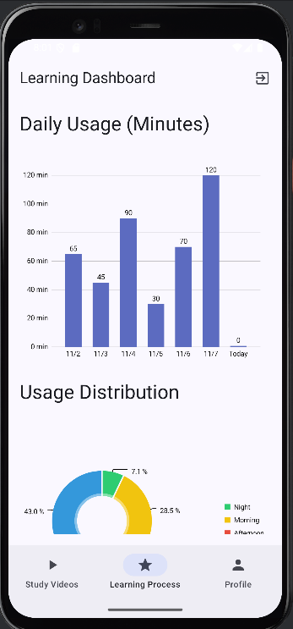
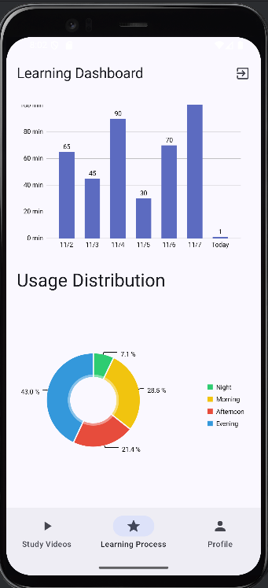
01
02
Daily Usage Overview Screen:
The Progress Screen visualizes the user’s activity over the past week.
A bar chart highlights how many minutes were spent each day, with the “Today” bar updating in real-time as the user continues using.
Usage Distribution Screen:
A pie chart shows how the user's usage time is distributed across different times of day (morning, afternoon, evening, night).
This helps users recognize when they are most active and understand their using habits.

Slide 10
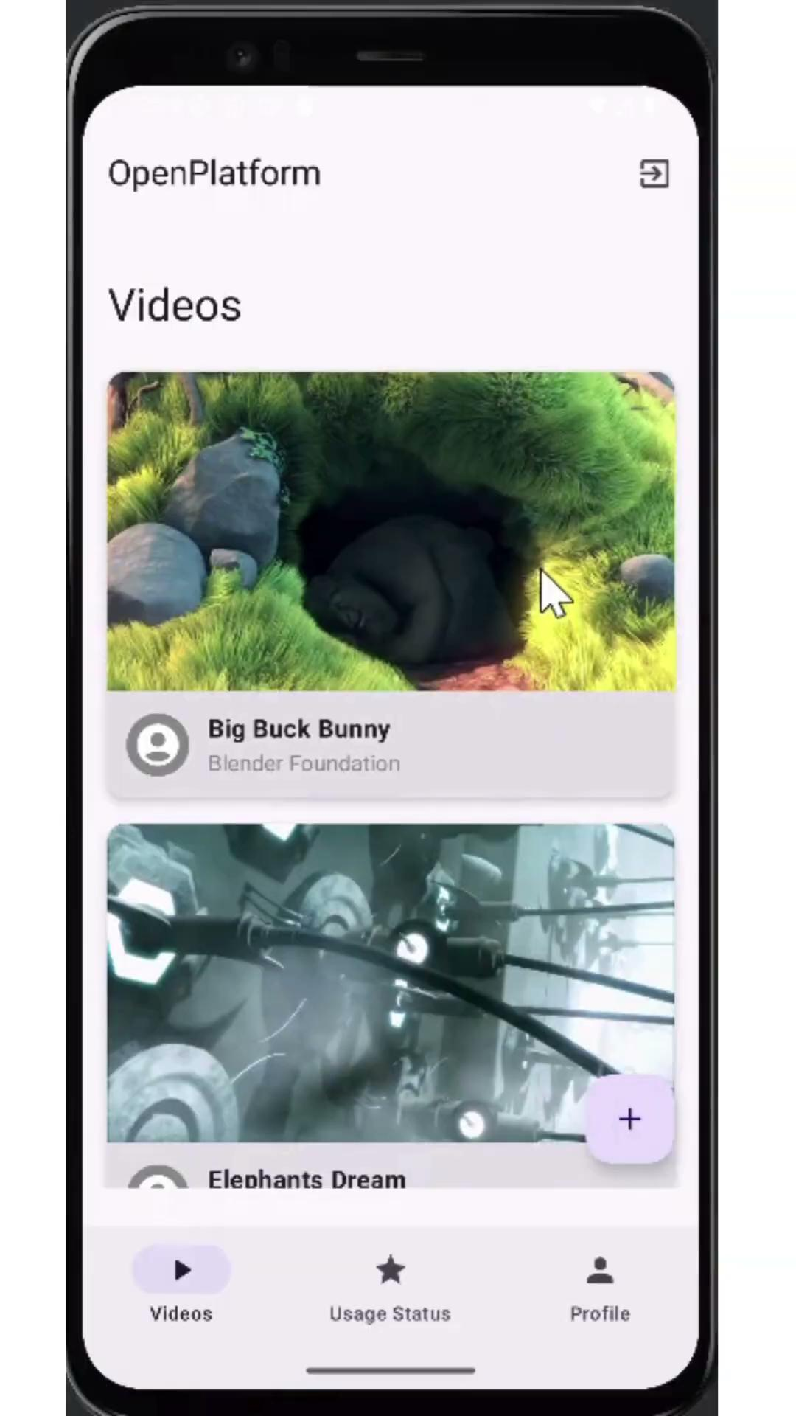
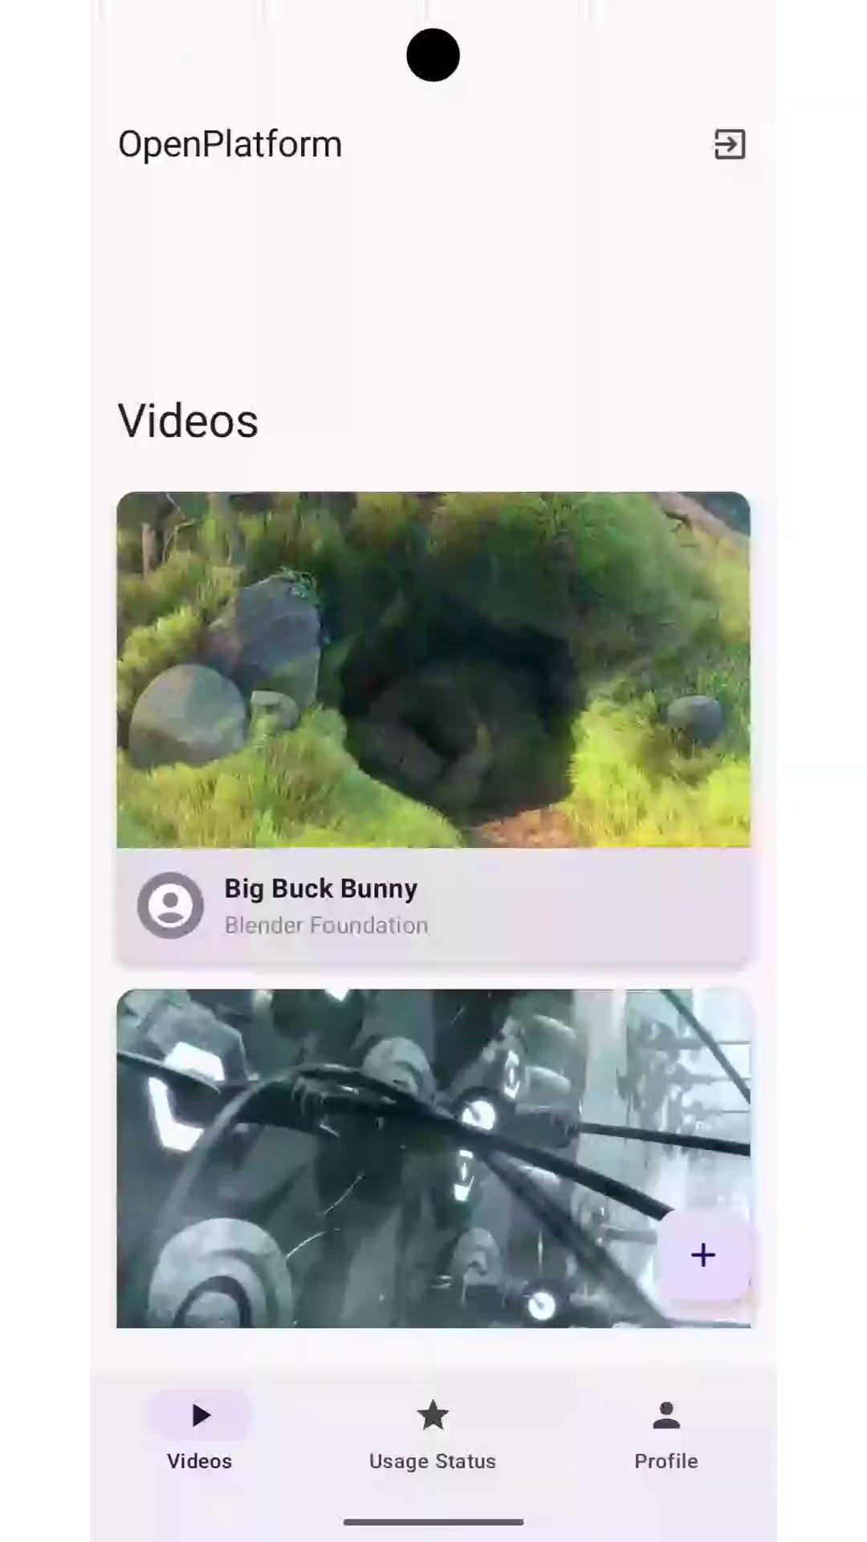
VIDEO OF THE FEATURES

Slide 11
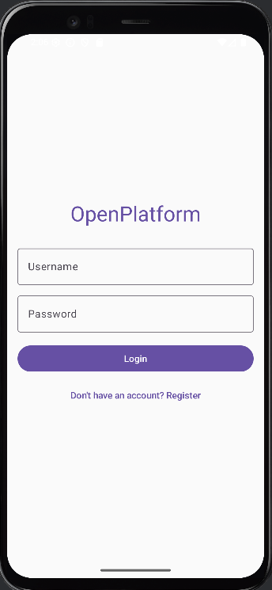
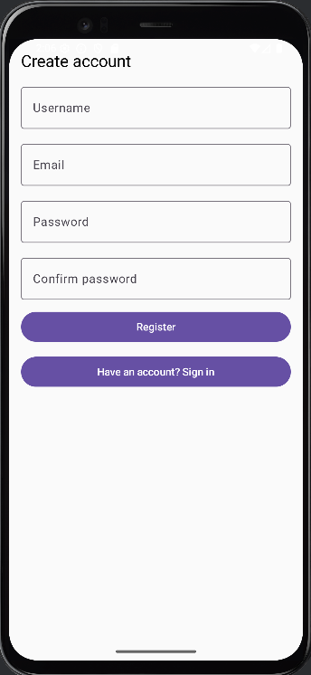
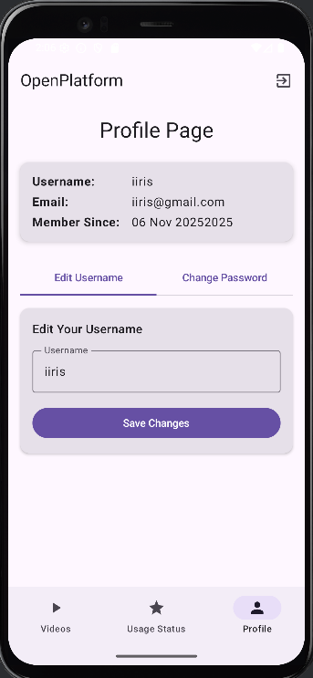
OTHER PAGES
Sign in Screen Registration Screen Profile Screen

Slide 12
ARCHITECTURE AND DATA FLOW
Uses a modern MVVM architecture for clear separation of responsibilities.
The app uses a clear, one-directional flow of data: UI → ViewModel → State → UI
The UI sends user actions.
The ViewModel updates the state based on those actions.
The UI automatically updates when the state changes.
Result: A predictable, stable, and easy-to-maintain application where the UI always reflects the current state.

Slide 13
DIFFICULTIES & FUTURE WORK
Difficulties Encountered:
•Build Errors: Getting all the different tools (like Hilt and KSP) to work together was tricky and caused many errors that we had to fix one by one.
Future Work:
•Improve User Accounts: Add more detail to the profile screen.
•More Charts: Add new types of charts to track different learning metrics.
•Search and Filter -feature

Slide 14

THANK YOU!
Questions?

